Slide 1
Creating Synthetic Instruments and Implementing Algorithms
Alex Smyntyna, Khadijah Nixon, James Broome, Hieu Dinh

Slide 2
<h2>TO Celcius</h2>
We Are From TAP
Alex Smyntyna ITEC Software Development Spring 2021
James Broome Business MIS Concentration Spring 2021
Khadijah Nixon ITEC Systems & Security December 2021
Hieu Dinh ITEC Software Development Fall 2019

Slide 3
What is TAP?
The Technology Ambassadors Program Provides an outreach to get students involved in getting ITEC minors or Majors.
An internship class on campus that helps prepare students ect.

Slide 4
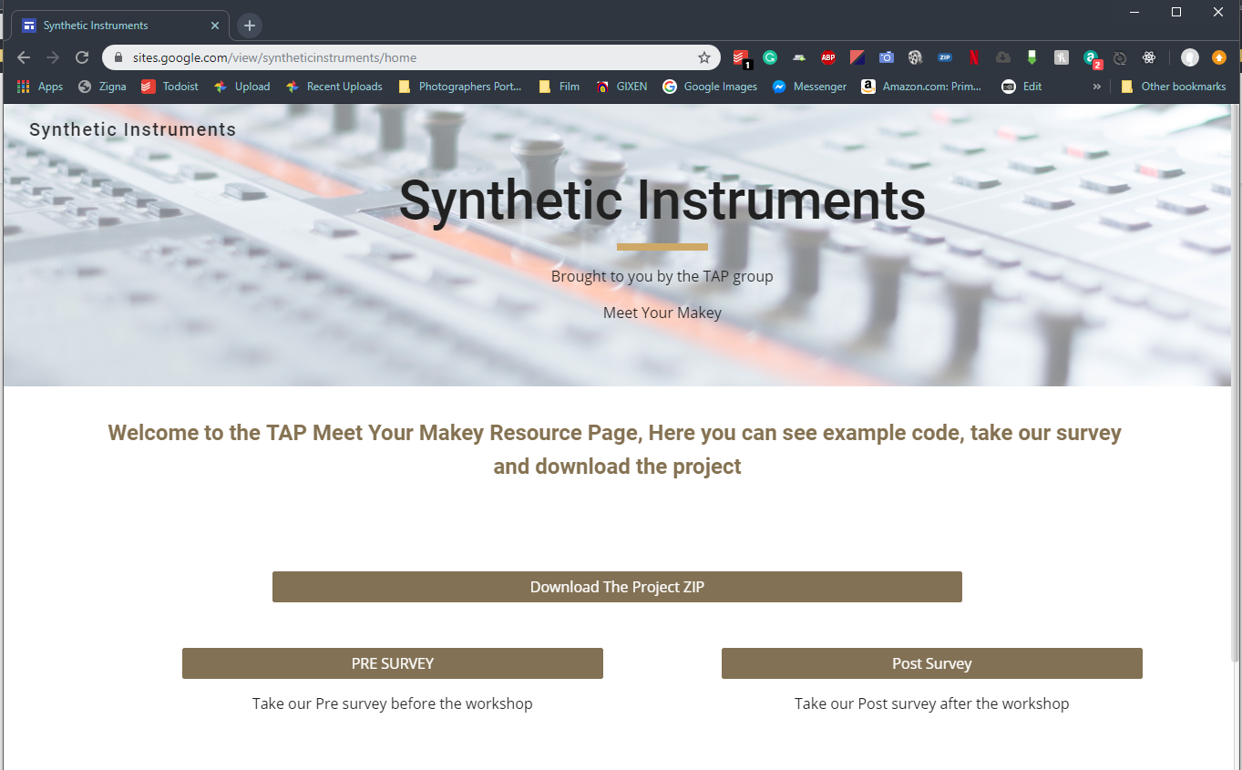
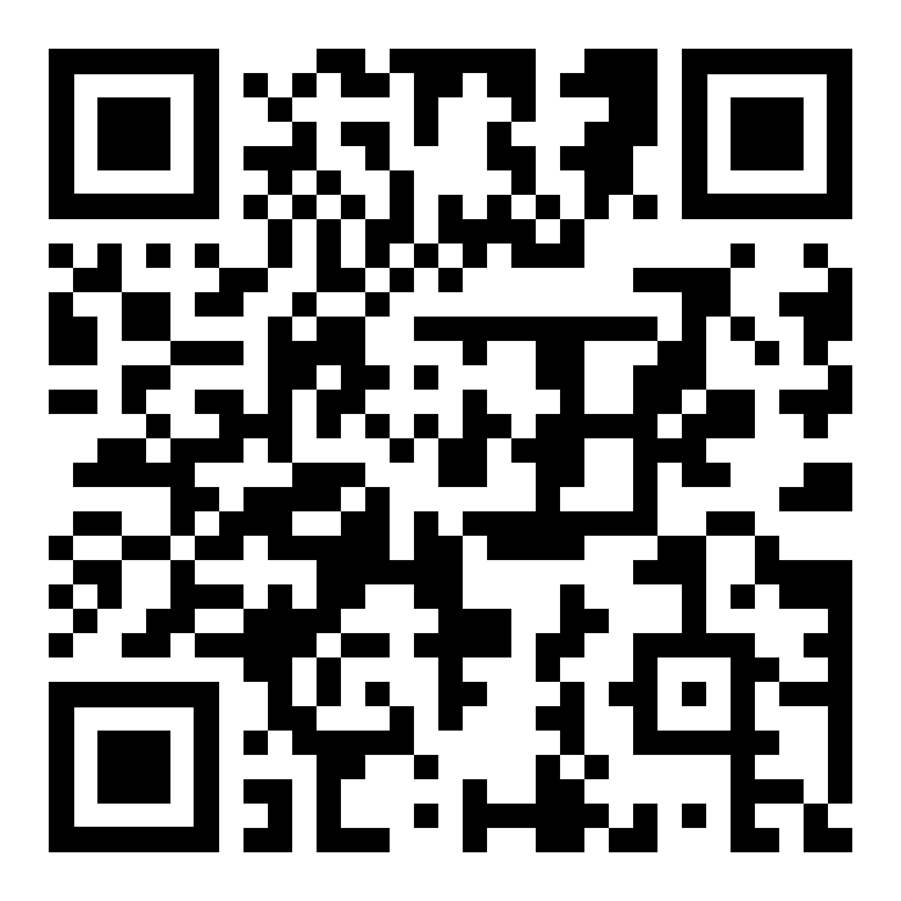
shorturl.at/hyOV3

Slide 5
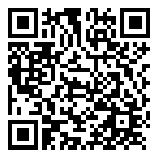
Pre - Survey
Scan QR Code or Go Back to our Webpage

Slide 6
What We Will Use
Makey Makey
Godot game engine
Cardboard
Conductive Components
Notes:
Add images and transitions

Slide 7
Live Demo
We need a Volunteer to play our instrument.

Slide 8
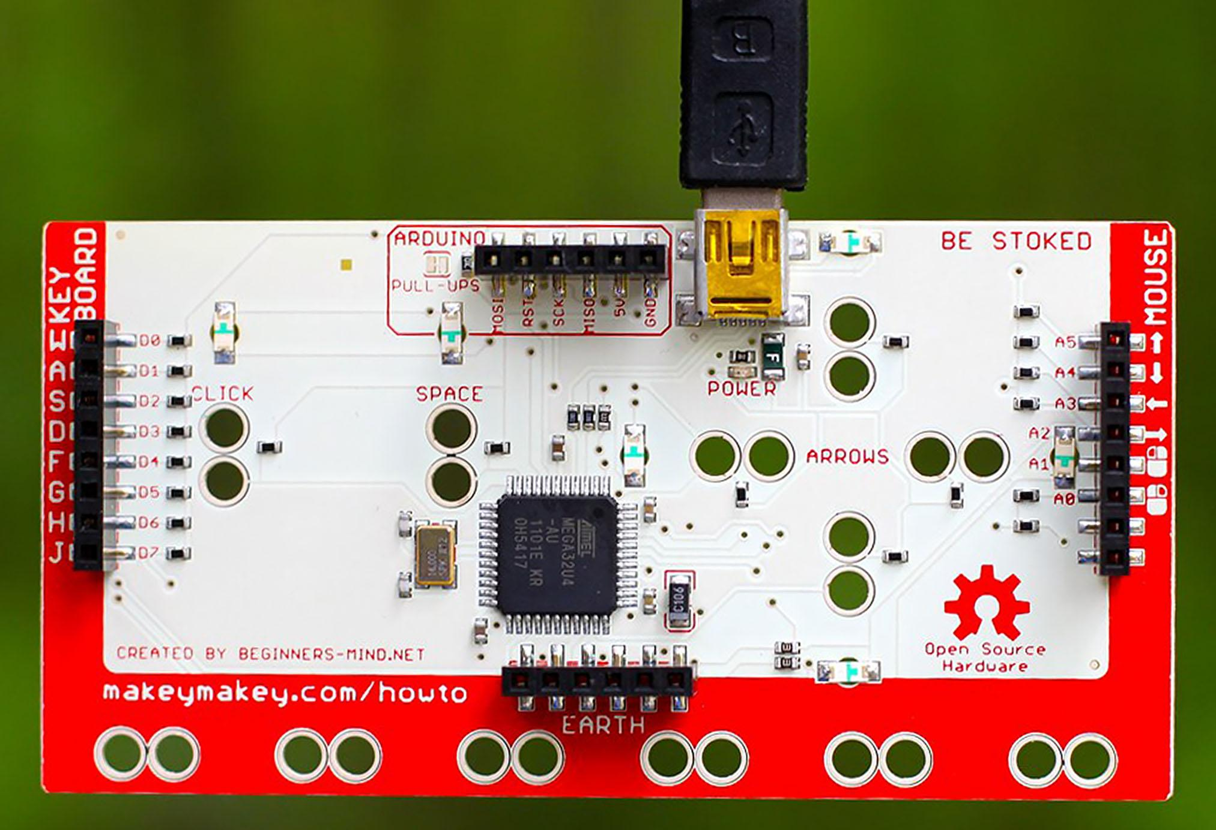
Makey Makey Connections
C
D
PITCH UP
E
PITCH DOWN
F
B
G
C5
A
GROUND

Slide 9
Building your own instrument
Arrange conductive materials on the cardboard in any way you like
There can only be 10 inputs; eight are the notes on your instrument, and two are to raise and lower the pitch
Connect wires to each input
Ground yourself with the black band, ground a metal rod, or ground part of your instrument

Slide 10
Running the program
Switch to Live Install
Notes:
ONLY FOLDERS ON DESKTOP, add slides for each step of install

Slide 11
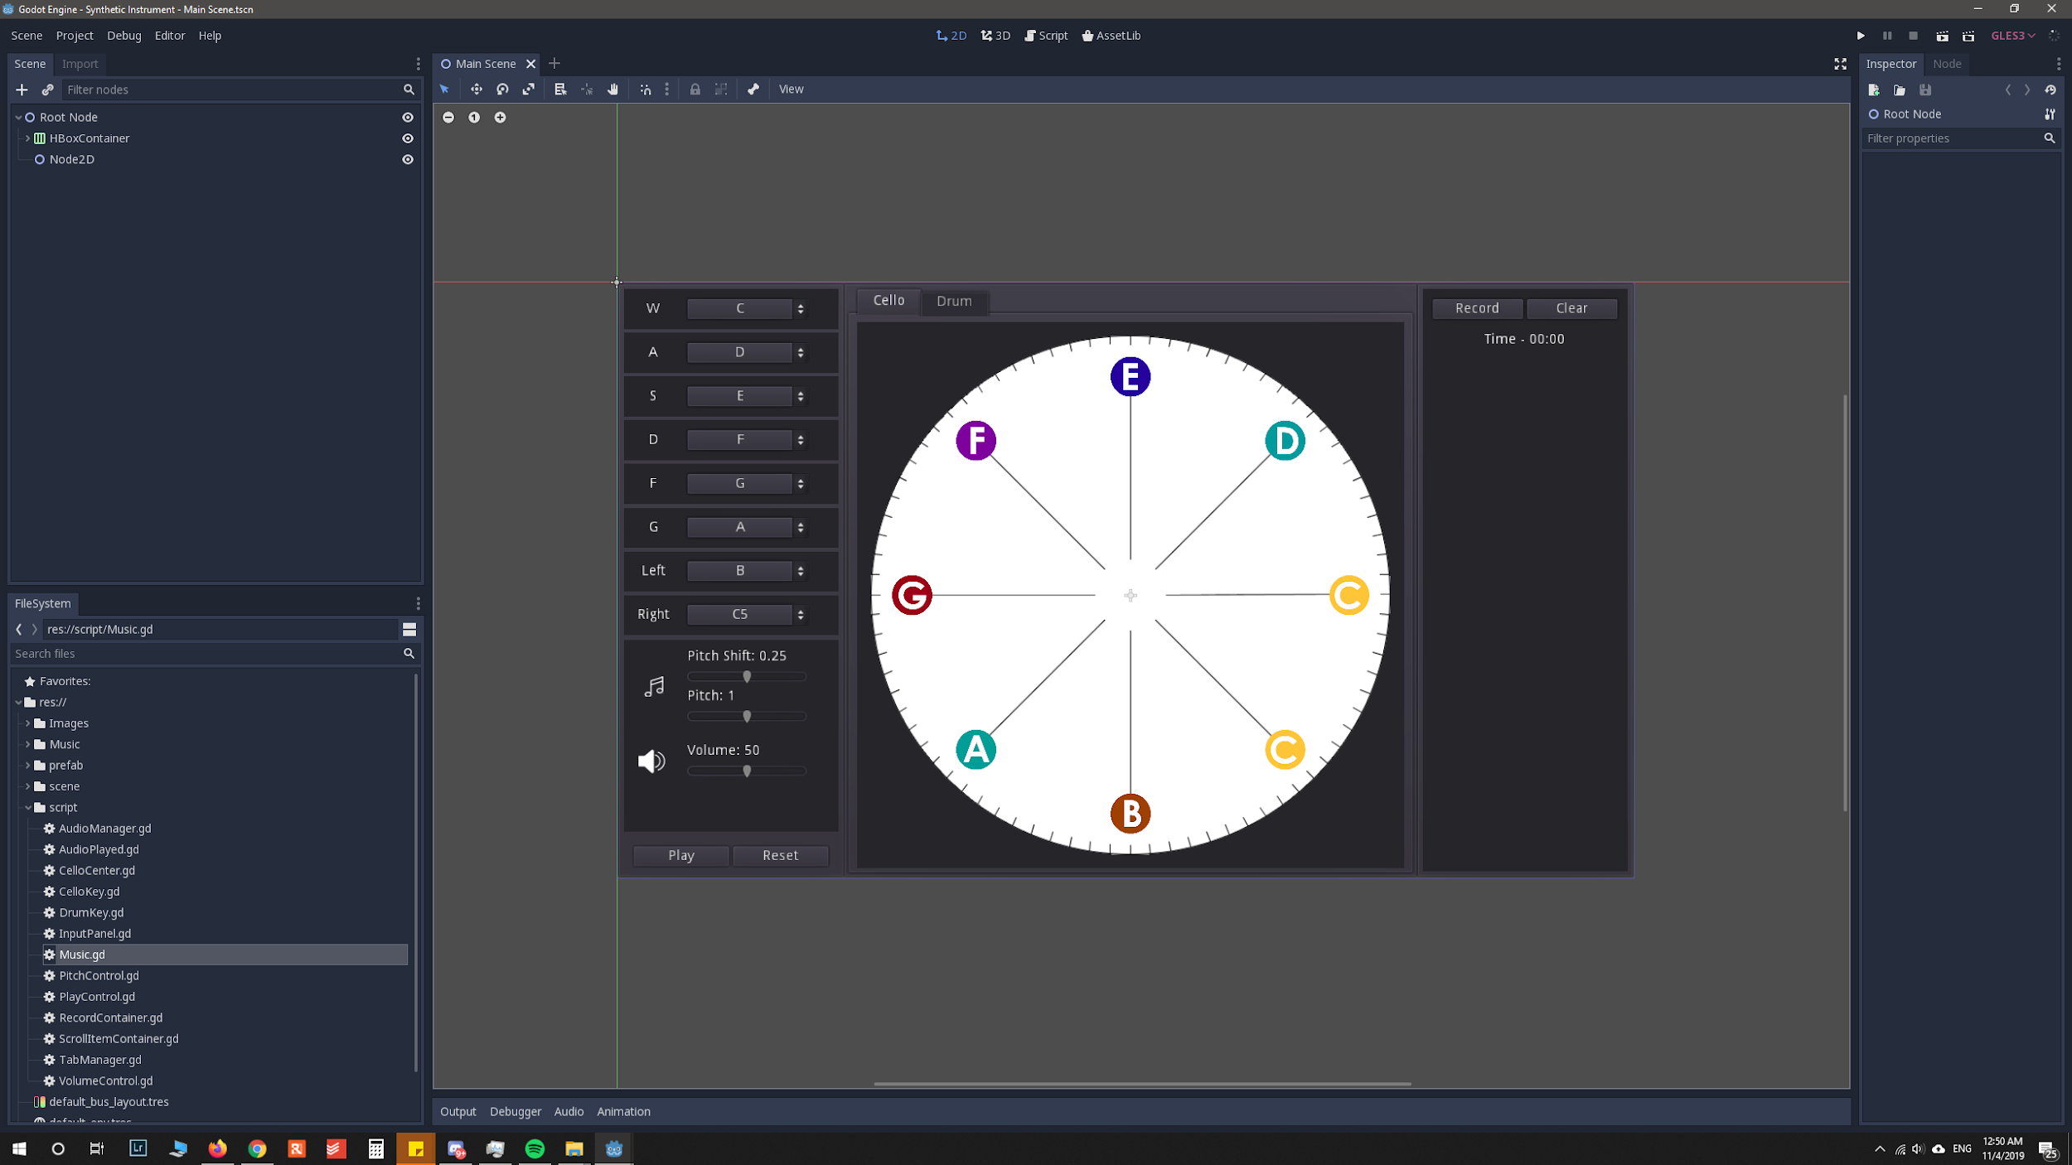
Set Up Godot
Time for you to open the Game Engine on your computer and load the project.
Open Music.gd in godot (double click)
Script -> Music.gd

Slide 12
How to encode your own music using python?
Open Music.gd which is in scripts

Slide 13
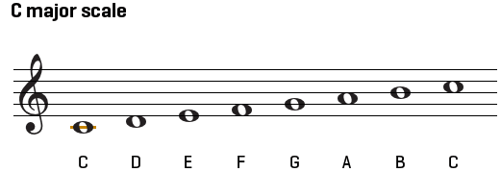
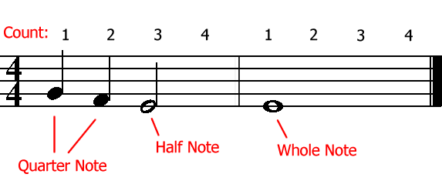

Slide 14
Live Coding!

Slide 15

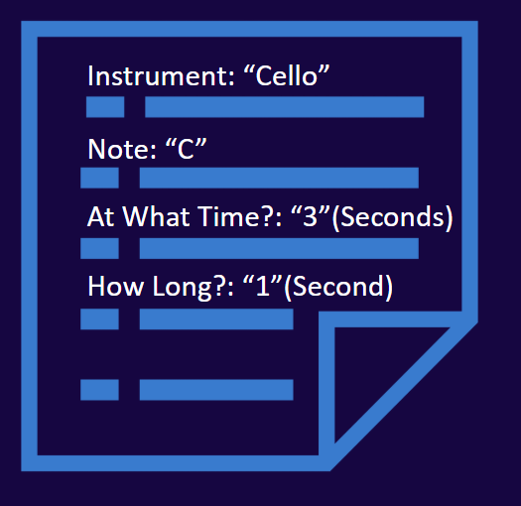
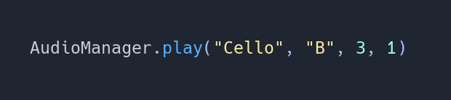
Variables
play
Instrument: “Cello”
Note: “C”
At What Time?: “3”(Seconds)
How Long?: “1”(Second)
Many Play Instructions

Slide 16
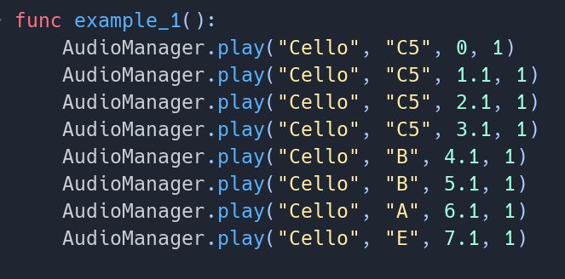
The instrument is the same
The note length is the same
}
8
Each note name is unique
Each call needs its unique time start

Slide 17
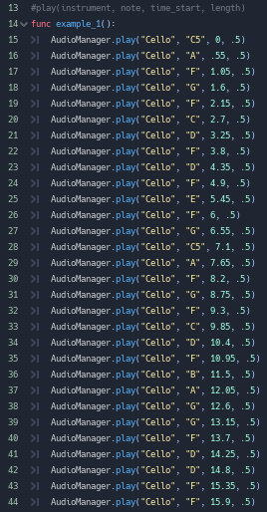
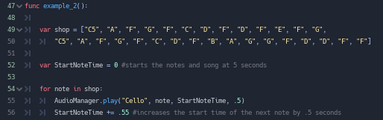
You can either write a song line by line...
Or you can take a more simplified approach

Slide 18
How can we make this easier and more efficient to code?
Create a list of these notes (Unique Data)
Have the computer add the time when the next note should start
Keep these variables the same

Slide 19
How can we make this easier and more efficient to code?
A list in python is what we call in programming an Array []
A grouping of data separated by commas, each in its unique spot
[] Square Brackets define this as an array variable
This is what I want to call it
What comes next is a variable
0 1 2 3 4 5 6 7
Each separated by a comma
It equals
Items in the array

Slide 20
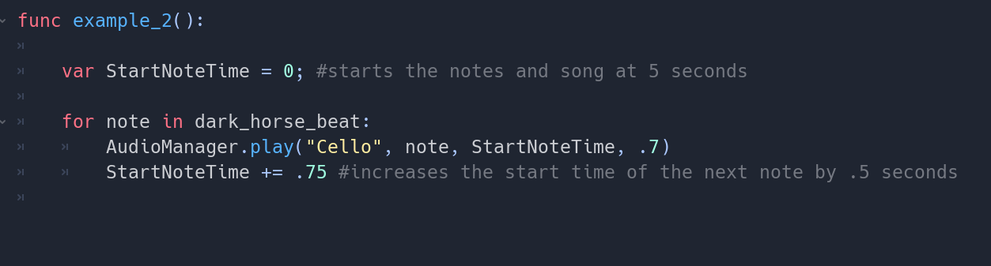


Any Name as it is only used in the for loop
Our Array of Notes
Add Our Constants

Slide 21
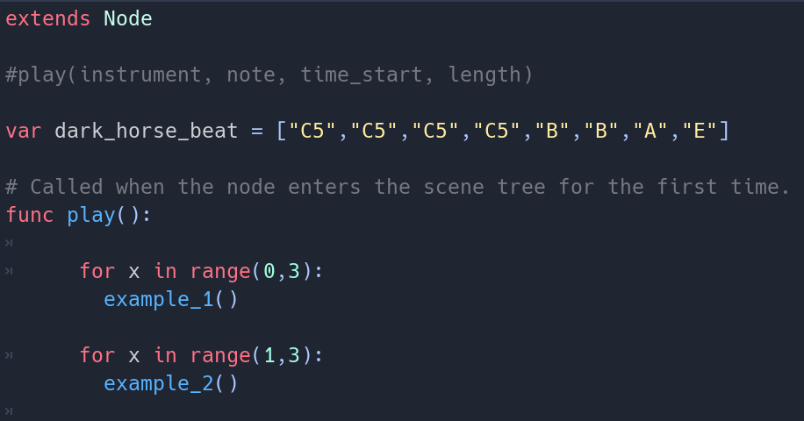
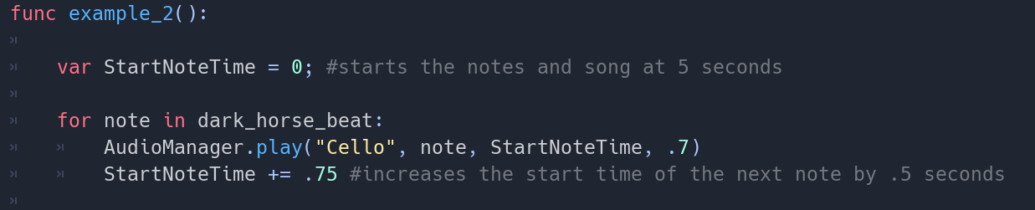

Slide 22
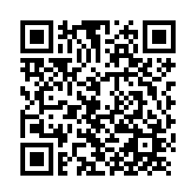
Thanks!
Any questions?
Go to our Website to Take the Survey
Or Go Directly to the Post Survey

